Slide 1
Chapter 1
Data structure and Programming Principles

Slide 2
Outline
Importance of Data Structure
Definition of data structure
Processing problems by computer

Slide 3
Importance of Data Structure
Information Period – big data and AI
Computing anywhere and any time
Development of computers: hardware & software
    Algorithms + Data Structures = Programs
Two Issues: Data Representation and Processing
    Data Representation and organization influence the efficiency of data processing.
    Along with the spread of various applications, amount of data increases sharply, and structures of programs becomes more and more complicated.

Slide 4

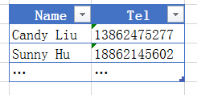
What is Data Structure
Case 1. Telephone Number Query System
  There is a telephone directory containing names and phone numbers of severed persons. The records could be arranged as a list of 2-tuple:
  Where ‘a’ and ‘b’ denote the name and phone number of a person respectively.
  An example illustrating the list structure of data.

Slide 5
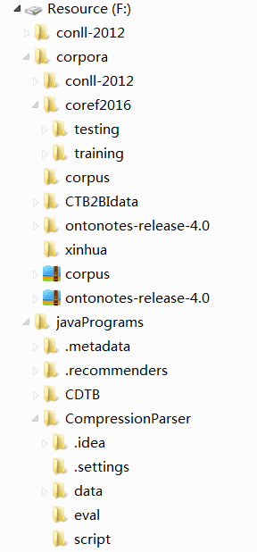
What is Data Structure
Case 2. File System
  There are many sub-directories and files in the root of the file system. Each subdirectory can have its sub-directories and files. In another word, one directory can contain multiple sub-directories, while one subdirectory only has one parent directory.
An example of the tree structure

Slide 6
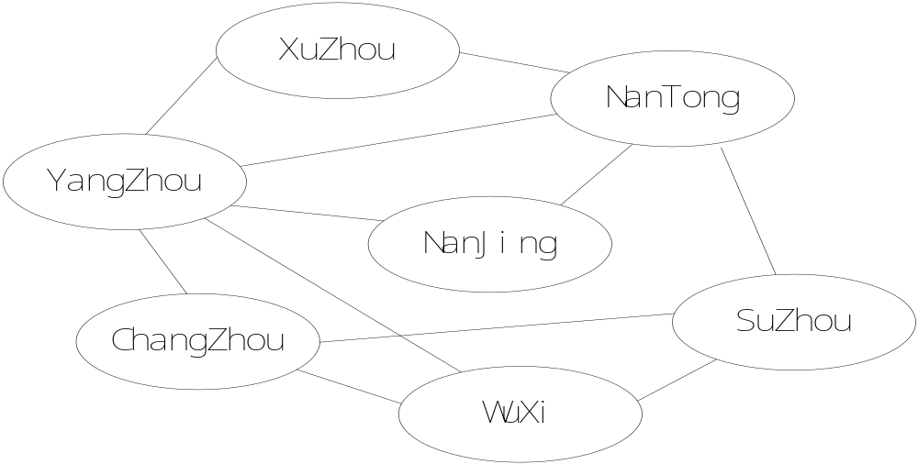
What is Data Structure
Case 3. Transport Network
  There are always multiple paths from one place to another place. This is a traditional problem of graph structure.
An example of the graph structure

Slide 7


What is Data Structure?
Fundamental Terms
  Data Layers:
    Data （数据）：a set of all the symbols that computer can manage.(所有能输入到计算机中并被计算机所识别和处理的符号的总称。)
    Data Elements （数据元素）:数据中的一个个体。a character ‘+’ or a student when it is stored in a computer.
    Data Item（数据项）:when the data element is a record, it can be divided into data items. Example : a student record may be combined by number, name, score and so on .
Notes:
Can deal with ,
the set must have a lot of subset ,such as the subset of digits, characters, strings, pictures, records, music songs, sounds, and so on.
If we draw a large circle as the data set, every subset can be represented as a smaller circle, every subset has many objects in it, and also it can have many subsets.
Every Data element is an independent individual in the data set. For example, a digital number, a character, a student record and so on.
So the number, name, score are three data items of the student record.

Slide 8
What is data structure
Data Structure: a particular way of organizing data in a computer so that it can be used efficiently.
  At logical level: logical relationships between data elements;
  At physical level:
    How the data is stored in memory
    Depending on the specific OS and programming language
  Operations performed on the data structure
    Define at logical level, and implement at physical level.

Slide 9
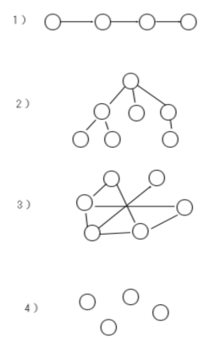
What is data structure
Logical Data Structure: the intrinsic relations between data elements.
  According to the difference of the relation ,we can classify them into four kinds.

Slide 10
What is Data Structure
    Storage Structure: （存储结构）Physical Structure in computer
      Contiguous structure
      Linked structure
      Hashing structure
      Index structure
Notes:
How to store the elements and the relation between them in a computer
the logical relation between the elements are represented by the location relation when they are stored in a block of contiguous memory. Usually we used the data type array in programming language to implement contiguous structure.
The logical relation between the elements are represented by the pointer adjunctive to the elements’ storage area. Usually we used the data type pointer in programming language to implement the linked structure.
supplement

Slide 11
What is data structure
Operation:
  Construct a new structure instance;
  Destroy a structure instance;
  Remove an element from the structure instance;
  Insert an element into the structure instance;
  Traverse the data structure instance;
  Replace/modify an element;
  Sort the elements;
  Search an element meeting some conditions

Slide 12
What is data structure
Relations among three levels of data structure
  Same logical structure can use different storage structures and be named differently.
    Eg. List --- Contiguous List, Linked List, Hash table
  Different terms are used to indicate that there are different operations conducted on the same logical structure.
    Eg. List --- Stack, Queue --- Contiguous/Linked Stack/Queue
  For algorithm design, logical structure is the focus. While the implementation of the algorithm mainly depend on storage structure.

Slide 13
Processing problems by computer
Outside Representation
Logical Structure
Storage Structure
Build
Model
Refine
Management
Demand
Basic Operation
Algorithm
Question
Mathematic model
Implement-
ation
在C++中实现时通常以类来实现数据结构及其上的操作
Notes:
To an application of real size, first we analyze what the problem is, find out what is the objects the question deal with and how to operate the objects.
Second ,we build the logic model of the application, this is about the relation between the objects, and find out what are the basic operations for every objects.
Third, it comes the stage of implementing, we must decide the details of how the data structures will be represented in computer memory and implement the base operation algorithms under the corresponding storage structure.
So there are three important tasks we will study in our following classes.

Slide 14
Processing problems by computer
Fundamental Tasks:
  Definition of Data Structure (including logical structure and base operations);
  Realization of Data Structure (including storage structure and base operations);
  Estimation and Selection of Data Structure (analysis of algorithms)
    Asymptotic Time Complexity（时间复杂度）
    Asymptotic Space Complexity（空间复杂度）

